Slide 1
EVERSHOLT LOWER SCHOOL
Information Evening
3rd November 2010
Notes:
The School held an Information Evening on Wednesday 3rd November 2010 regarding the Creative Curriculum. It was very well received based on feedback from the parents who attended, and so we are distributing these summary notes for the information of all parents & carers.
It is not the full presentation that we gave, but should provide some detailed insight into our motivations and objectives for “Creativity” at Eversholt Lower School.

Slide 2
Format
Presentation
Why are we taking a creative approach to learning?
What does that actually mean?
How have we implemented it?
Discussion
What have the issues been?
What are the benefits we have seen?
What lessons have been learnt?
Summary
What’s next?
Notes:
At the start of the Autumn Term in 2008, the school introduced the “creative curriculum”. The purpose of the information evening was to provide an update to parents on the creative curriculum, and get feedback from Governors, Staff, Parents and Children.
The format of the evening was a presentation on why the school takes a creative approach to learning, what that actually means, and how delivery of the national curriculum in a creative teaching style been implemented. This was followed by an open discussion of issues, benefits and lessons learnt.
We then summarized what we see as next steps and plans for further development of the creative curriculum at the school.

Slide 3
How well is the school doing?
No National data available
“Children have an outstanding start in the EYFS class…. Standards are much higher than those seen in most schools”
Ofsted, 26th January 2009
Points are scored for the number of children attaining certain levels through teacher assessment. The higher the level the more points. Average Point Scores (APS) across all 6 areas of Learning for the Foundation Stage.
Notes:
Academic Standards at the school are exceptionally high.
In Early Years Foundation Stage (Star Class), standards are measured by a points system. Points are scored for the number of children attaining certain levels through teacher assessment - the higher the level of achievement, the more points. Average Point Scores across all 6 areas of Learning for the Foundation Stage are shown below for Eversholt and the national average. We consistently score far higher than the national average, and our last Ofsted report stated that:
Ofsted reported that “Children have an outstanding start in the EYFS class…. Standards are much higher than those seen in most schools”.

Slide 4
Standards & Progress
+7.8
“Consistently exceptionally high standards at end of Year 4”
John Carter – School Improvement Partner, Sept 2010
Average Point Scores (APS) across the three subjects of Reading, Writing and Maths in Key Stages 1 and 2. The suggested progress should be 6 points from end of Y2 to end of Y4.
Notes:
In Key Stage 1 (KS1, Years 1 &2 – Moon Class) standards are again measured by a points system for numeracy, reading and literacy. One point is an approximate measure of the achievement that is expected in 1 term, so in a school year pupils are expected to make 3 points progress in attainment. The results for Eversholt and the national averages for KS1 are shown on the left hand graph above.
At the end of KS1 our children are, on average, 3 points – effectively 1 year - ahead of the national average.
In Key Stage 2 (for Lower Schools this means end of Year 4) the data is shown on the right hand graph. On average children leave us 4 points above the national average, having made 7 to 8 points of progress in their attainment compared to the expected gain of 6 over Years 3 and 4. As such the school provides “consistently exceptionally high standards at end of Year 4” according to Central Beds appointment School Improvement Partner.
Having achieved Outstanding School status and with high academic standards, the challenge to the school has been to continually improve on the delivery and educational experience of the children. One of the central pillars of our school improvement is through a focus on creativity.

Slide 5
2030
Notes:
Before providing a detailed explanation of what we mean by creativity, we need to pause and introduce some of the motivations for our approach.
Eversholt pupils currently in Sun Class won’t enter the workforce until 2020 at the earliest. For pupils starting in Star class this term and who go onto to University education, it will be nearer the year 2030.
We live in fast moving, innovative world. To illustrate this we showed a video called “Did You Know?”, which is a well known Internet video from 2008 that tries to illustrate just how fast moving the world is , and that we truly live in “exponential times”.
The YouTube link to this video is below and it provides some colourful context for the rest of our discussion.
http://www.youtube.com/watch?v=Y2o2L5DUIuw

Slide 6
Screen shot – 2010 jobs 2004…
What new jobs will be in demand in 2020?
Notes:
One of the most striking thing to consider is the idea that many of the most sought after jobs in 2020 & 2030 probably don’t even exist yet. At the European Futurists Conference held in Lucerne in 2010, the kinds of jobs that will exists in 2020, but don’t exist now, was debated. Examples included:
1. Body Part Maker: Due to huge advances in bio- tissues, robotics and plastics, the creation of body parts - from organs to limbs - will soon be possible requiring body part makers, body part stores and body part repair shops.
2. Nano-Medic: Advances in nanotechnology offer the potential for a range of sub-atomic ‘nanoscale’ devices, inserts and procedures that could transform personal healthcare. A new range of nano-medicine specialists will be required to administer these treatments.
3. Vertical Farmers: There is growing interest in the concept of city-based vertical farms, with hydroponically-fed food being grown in multi-storey buildings. These offer the potential to dramatically increase farm yield and reduce environmental degradation. The managers of such entities will require expertise in a range of scientific disciplines, engineering and commerce.
4. Climate Change Reversal Specialist : As the threats and impacts of climate change increase, a new breed of engineer-scientists will be required to help reduce or reverse the effects of climate change on particular locations. They will need to apply multi-disciplinary solutions ranging from filling the oceans with iron filings to erecting giant umbrellas that deflect the Sun’s rays.
5. Memory Augmentation Surgeon: Surgeons that add extra memory to people who want to increase their memory capacity and to help those who have been over-exposed to information and simply can no longer take on any more - thus leading to sensory shutdown.
6. Weather Modification Police: The act of stealing clouds to create rain is already happening, altering weather patterns thousands of miles away. Weather modification police will need to control and monitor who is allowed to shoot rockets containing silver iodine into the air - a way to provoke rainfall from passing clouds.
7. Waste Data Handler: Specialists providing a secure data disposal service for those who do not want to be tracked - electronically or otherwise.
8. Social ‘Networking’ Worker: Social workers for those in some way traumatised or marginalised by social networking.
9. Personal Branders: An extension of the role played by stylists and executive coaches - advising on how to create a personal ‘brand’ using social and other media. What personality are you projecting via your Twitter? What personal values do you want to build into your image? Is your image consistent with your real-life persona.

Slide 7
We live in a fast moving world
“In times of radical change learners inherit the earth - while the learned find themselves beautifully equipped to deal with a world that no longer exists”
Eric Hoffer
Notes:
We are currently preparing students for jobs that don’t exist yet, using technologies that haven’t been invented, in order to solve problems that we don’t even know are problems yet. The challenge for parents and schools is equipping children with skills required for them to thrive in an exponentially faster moving world. These focus on:
Critical thinking, problem-solving skills, and applied knowledge for practical results
Mastery of rigorous academic content, especially in literacy, mathematics, and information technologies
Innovative and creative thinking, including entrepreneurial skills
Communication skills, both oral and written
Team learning and work, relationship building, and interpersonal social skills
Personal responsibility, including good work habits, work ethic, knowing how to be flexible and continue learning, and financial literacy
Global awareness, languages, and understanding other cultures (including history, economics and geography)
In a world where much of the knowledge, facts & technology are rapidly changing, whatever you learn “now” has less and less value as time passes. Learning how to analyse, evaluate & understand what is “now”, and critically how it is changing, and then apply that understanding in creative ways, that is the way to be equipped for times of radical change.

Slide 8
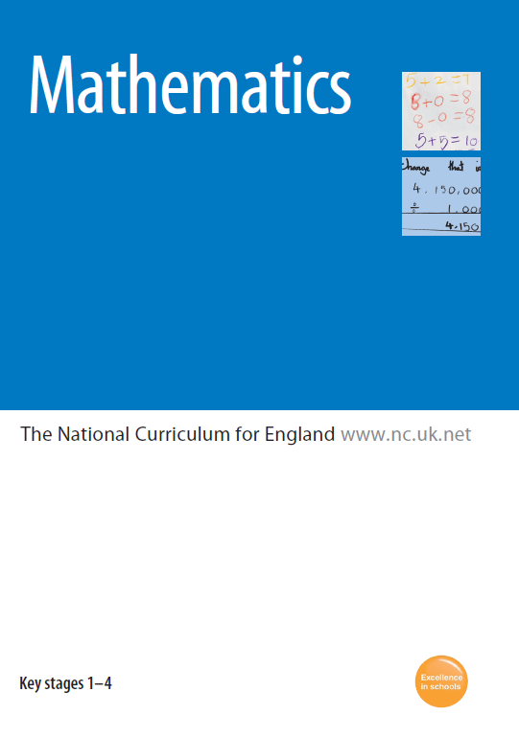
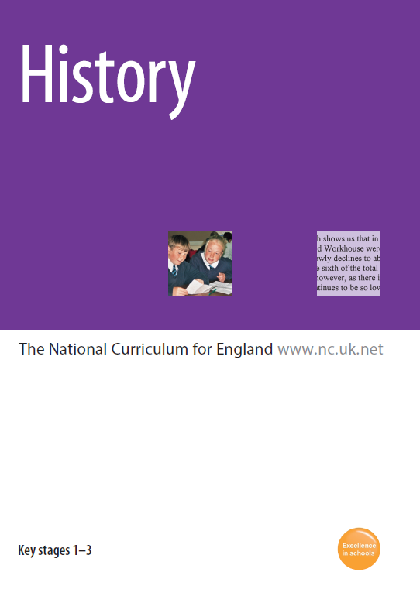
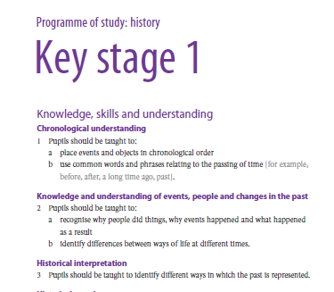
The National Curriculum
Notes:
Now, it used to be that teaching was “topic based” in schools. However, the introduction of the National Curriculum created a rigid framework for teaching based on learning objectives in segmented curriculum subjects. This took away much of the flexibility in teaching that topic based approaches require.

Slide 9
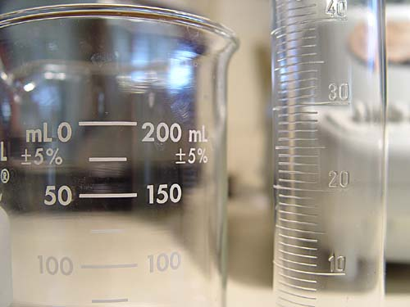
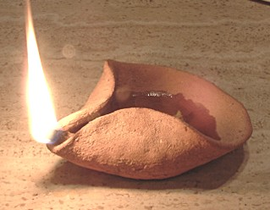
A Problem: Narrowness not enquiry
Notes:
There was a realization that something was being lost in the implementation of the National Curriculum. Successful learners are creative & resourceful, are able to identify and solve problems, have enquiring minds and think for themselves to process information, reason, question and evaluate. They enjoy learning which motivates them to achieve the best they can now and in the future. However, the National Curriculum was starting to encourage “narrowness” in learning rather than “enquiry”. The analogy we use is that it treats learners as “vessels to be filled” rather than “lamps to be lit”.
This was and isn’t just a problem in the UK. In Japan, for example, there is pressure for change in the approach to education, as the Japanese seek to encourage more individuality and creativity to better equip the nation for innovation and economic growth. Characteristics of the educational system that may inhibit the development of creativity in Japanese children are deemed to include the rote memorization required for examination preparation, the impact of the examinations in undermining “intrinsic” or self-motivation, and the low tolerance for deviation from conventional thought.
In 2004, the Government in the UK produced the “Excellence & Enjoyment” report which gave schools a framework to introduce creativity into their approach to the National Curriculum.

Slide 10
What is Creativity?
Notes:
In this context creative does not mean artistic.
Rather, it means the ability to think and act "out of the box“, discover new and innovative ways of thinking and doing things, to be inventive, take risks and challenge convention.
The Government defines creative activity as:
Always involves thinking or behaving imaginatively
This imaginative activity is purposeful: that is, it is directed to achieving an objective (i.e. not day dreaming!)
Generate something original
The outcome must be of value in relation to the objective
We are all, or can be, creative to a lesser or greater degree if we are given the opportunity. Like any skill, the early it is seeded, the greater the potential outcome.

Slide 11
Why is Creativity seen as so vital?
Creativity improves pupils' self-esteem, motivation and achievement
Creative pupils lead richer lives
Creativity prepares pupils for life: an important aim of the national curriculum
Notes:
Creativity improves pupils' self-esteem, motivation and achievement. They become more interested in discovering things for themselves, more open to new ideas & willing to work beyond lesson time when pursuing an idea or vision. As a result, their pace of learning, levels of achievement and self-esteem increase.
Creative pupils lead richer lives by providing the opportunity to discover and pursue their particular interests and talents.
Creativity prepares pupils for life, which is an important aim of the national curriculum. Changing circumstances in the business world have lead employers to demand not only high academic achievement but also people who can be innovative, creative and who can adapt to the changing environment with good communication skills. The National Curriculum Handbook states that the curriculum should give pupils “the opportunity to become creative, innovative & enterprising to equip them for their future lives as workers and citizens”.

Slide 12
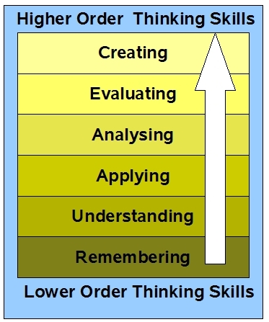
Higher Order Thinking
Best practise in Gifted & Talented Teaching is to encourage higher order thinking and skills
“Placing creativity at the heart of G&T education - raising aspirations and promoting creative and divergent thinking amongst your learners” Zoe Elder, G&T Learning Manager, Somerset
Notes:
Creativity is one of the higher order thinking skills, characterised above in what is known as Blooms Taxonomy. Best practise in the teaching of Gifted and Talented children is to encourage the stimulation and development of higher order thinking skills. Within the classroom this leads to the following “creative behaviours”:
questioning and challenging
envisaging what might be
exploring ideas, keeping options open
reflecting critically on ideas, actions and outcomes
making connections and seeing relationships
At Eversholt, we believe that all our children can benefit from methods and style of teaching that stimulate, and start the development of these higher order thinking skills. The system by which we do this is called the Creative Curriculum.

Slide 13
Seeing the “Whole Picture”
English
Religious Education
Physical Education
Personal, Social & Health Education
Geography
To Infinity &
Beyond
Music
Art & Design
Science
Chazchink
History
Design & Technology
Citizenship
Mathematics
ICT
Try to avoid over-compartmentalised teaching. If pupils see ‘the whole picture’ and are helped to recognise relationships and patterns in their learning, they will gain a deeper understanding.
National Curriculum Handbook
Notes:
The Creative Curriculum takes the National Curriculum content, and uses a “thematic” (topic or theme) approach to teach multiple learning objectives across different subject areas. In avoiding narrow subject based lessons, pupils have the opportunity to see linkage between subject areas and learning objectives. By seeing ‘the whole picture’ they are helped to recognise relationships and patterns in their learning, and they will gain a deeper understanding.

Slide 14
How have we implemented it?
Class | 2008 |  |  | 2009 |  |  | 2010
 | Autumn | Spring | Summer | Autumn | Spring | Summer | Autumn
Star | Best of British | Toys | Minibeasts | To Infinity & Beyond | Festivals | All Creatures Great & Small | Around the World in 71 days
Moon |  | Turrets & Tiaras | Splish,Splash,Splosh |  | Roll Up! Roll Up! | Kapow - How?
 |  |  |  |  | Flight & Fantasy | Wings, Claws & All Fours
Sun |  | Some like it hot! | Swords & Sandals
Notes:
The key principles in our implementation are to build on pupils’ interests and experiences (both in and out of school) using role play to increase pupils’ imagination & engagement, to give them freedom to explore ideas including hands-on experimentation, problem solving, discussion and collaborative work.
Each Autumn term we have a whole school theme, then in the Spring and Summer Terms each class has it’s own themes. Class based themes can be repeated on a two year cycle, while the whole school theme is not repeated as we have to allow time for children to pass through all year groups with repetition.
We never lose sight of the importance of knowledge and skills. The Higher Order skills have to be built on a solid foundation - pupils are only able to engage creatively and purposefully with the challenges they encounter if they have a solid base of knowledge and skills. For this reason some subjects are taught wholly or in part “standalone”. These are Numeracy, Literacy (Spellings & Grammar), some Science, RE & PE.

Slide 15
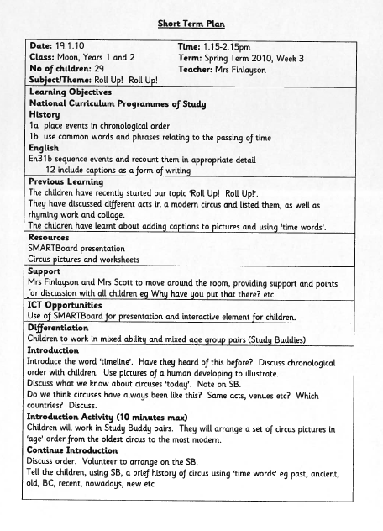
Planning
Lesson Planning links different curriculum areas into coherent activities
Notes:
The implementation of the Creative Curriculum requires a high degree of planning and oversight to ensure that academic standards remain high. Lesson planning by teachers is rigorous, and identifies learning objectives from the National Curriculum framework, opportunities for cross-linking of subjects, use of Information Technology etc.
We then engage in a National Curriculum cross checking exercise, where each term we ensure that the learning objectives covered in the creative curriculum adequately cover the National Curriculum. This ensures that we track and can correct for any omission or subject area that has not been properly covered. Oversight is provided by the Head Teacher, the Curriculum Governors, our School Improvement Partner and Ofsted.
Note: The School Improvement Partner is a Local Authority appointed educational consultant who works with the school to provide improvement objectives and advice.

Slide 16
We have a moment in time to
educate and inspire but we all
have a lifetime to learn
Notes:
At Eversholt school we believe we create a buzz of excitement from pushing boundaries, finding solutions and solving problems. Having started our implementation of the Creative Curriculum in September 2008, we feel it has been a success and we have maintained our exceptionally high academic standards while fostering the creativity of our pupils. Our goal now is to be a Centre of Excellence in the delivery of the Creative Curriculum.
Our aim is that children leave us with exceptional standards in reading, writing, numeracy & science together with emerging skills in creative & critical thinking, problem solving, teamwork, research, analysis & communication. We seek to foster self-motivation, excitement & love of learning.

